Slide 1


Introduction to Circuits Analysis
by Andrew G. Bell
abell118@ivytech.edu
(260) 481-2288
Chapter 17
Capacitance

Slide 2
Capacitor
An electrical component consisting of two conductors (plates) separated by an insulator (dielectric)
A component that opposes a change in circuit voltage

Slide 3
Dielectric Materials
Vacuum Glass
Air Ceramic
Paper Aluminum Oxide
Plastic Tantalum Oxide

Slide 4
Electrical Definition of Capacitor
An electrical component that stores energy in the form of electrical charge when voltage is applied

Slide 5
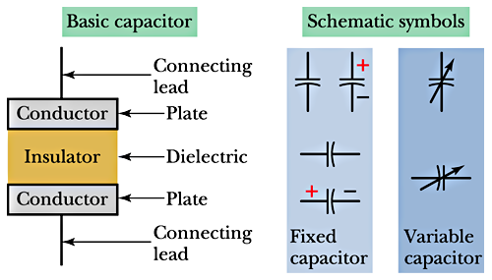
Basic Symbols

Slide 6
Capacitor Action
Applied voltage forces electrons onto one plate. The electrostatic field associated with a charged particle forces electrons off of the opposite plate.

Slide 7
Capacitor Charging
Applied voltage causes circuit current to flow. Plates of the capacitor become charged as one plate accumulates electrons and the other releases electrons. Circuit action continues until:
V_{C} = V_{S}

Slide 8
Capacitor Discharge
A charged capacitor will discharge when a path is provided between the two plates.
The plate with excess electrons will give up electrons to the plate with a deficiency until:
V_{C} = 0 V

Slide 9
The Farad
Capacitance is the capacity of a capacitor to store electrical charge.
The unit of measure is the farad (f).

Slide 10
Charge and Voltage

Slide 11
Energy Stored in Field
Energy = joules stored
C = capacitance (farads)
V = voltage

Slide 12
Factors and Value
ITEM
Plate area
Plate distance
Dielectric material
RELATIONSHIP
Direct
Inverse
Direct

Slide 13
Dielectric Constant
∈₀: Absolute permittivity of dielectric
materials
∈_{v}: Absolute permittivity of vacuum

Slide 14
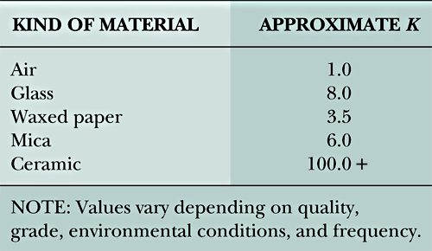
Dielectric Types

Slide 15
Dielectric Strength
The breakdown voltage rating of a given material and dimensions
Dielectric material reaches point where punch-through occurs

Slide 16
Capacitor Formula
Use Excel to evaluate how Area, Spacing and dielectric constant change the capacitance of a parallel plate capacitor
C = capacitance (farads)
A = area of plates (sq. meters)
s = spacing between plates (meters)
8.85 = constant for air/vacuum
Excel

Slide 17
Finding Total Capacitance
For series capacitors:
  Sum of the reciprocals

Slide 18
Finding Total Capacitance (cont.)
For two series capacitors:
  Product-over-the-sum

Slide 19
Finding Total Capacitance (cont.)
For parallel capacitors:
  Direct summation

Slide 20
Total Capacitance
Using Excel calculate the total capacitance of each circuit
Excel

Slide 21
Series Voltage Distribution
V_{X} = voltage across capacitor x
V_{S} = DC source voltage
C_{T} = total series capacitance
C_{X} = value of capacitor x

Slide 22
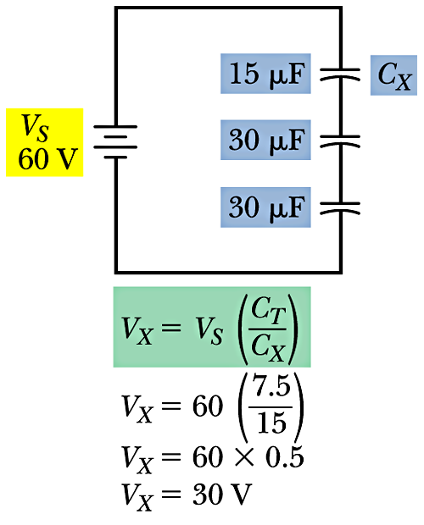
Example
Use Multisim determine the voltage across each capacitor
Multisim
Multisim

Slide 23
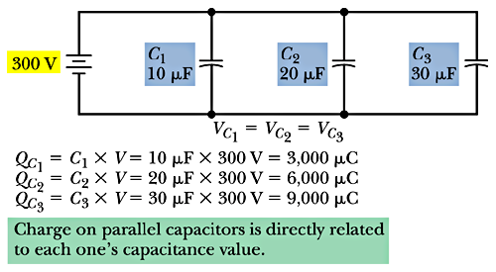
Charge Distribution
In parallel circuits:

Slide 24
RC Time Constant (τ)
Time required for a capacitor to charge or discharge 63.2% of the change in voltage level applied
Five time constants are needed to fully charge/discharge

Slide 25
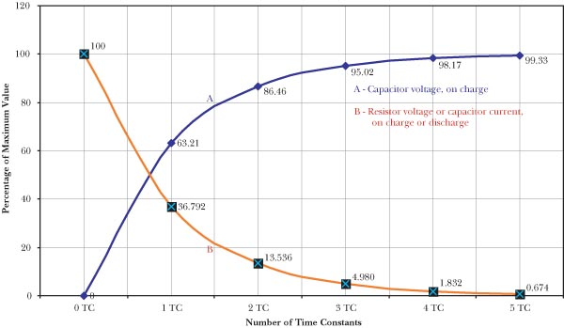
Time Constant Chart

Slide 26
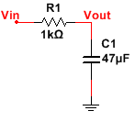
Assuming a 9V Square wave input Use Multisim and Excel to determine the RC Time Constant and plot the transient response
R = | 1.0E+3 | ohms
C = | 47.0E-6 | farad
τ = | 47.0E-3 | seconds
5τ = | 235.0E-3 | seconds
pulse width = | 235.0E-3 | seconds
period = | 470.0E-3 | seconds
Excel
Multisim

Slide 27
Exponential Form for Charging Capacitors
∈ = epsilon (or 2.71828)
t = time allowed (seconds)
τ = R × C (or 1 time constant)

Slide 28
Exponential Form for Discharging Capacitors
∈ = epsilon (or 2.71828)
t = time allowed (seconds)
τ = R × C (or 1 time constant)

Slide 29
Capacitor Types
FIXED
Paper/Plastic
Mica
Ceramic
Electrolytic
Chip
VARIABLE
Trimmer
Air

Slide 30
Ratings
Temperature
Tolerance
Voltage Rating
Temperature Coefficient
Power Factor
Inductance Characteristics (at high frequencies)

Slide 31
Safety
Always discharge circuit capacitors after power has been removed and before working on circuits containing them.
Observe polarity when connecting electrolytic capacitors into a circuit.

Slide 32
Ratings
Physical Size and Mounting
Capacitance Value
Capacitance Tolerance
Working Voltage Ratings
Temperature Range
Temperature Coefficient
Inductance

Slide 33
Typical Problems
Ohmmeter Tests
Opens
Shorts

